Slide 1

American dietary change and the environmental implications

Slide 2
Introduction

Slide 3
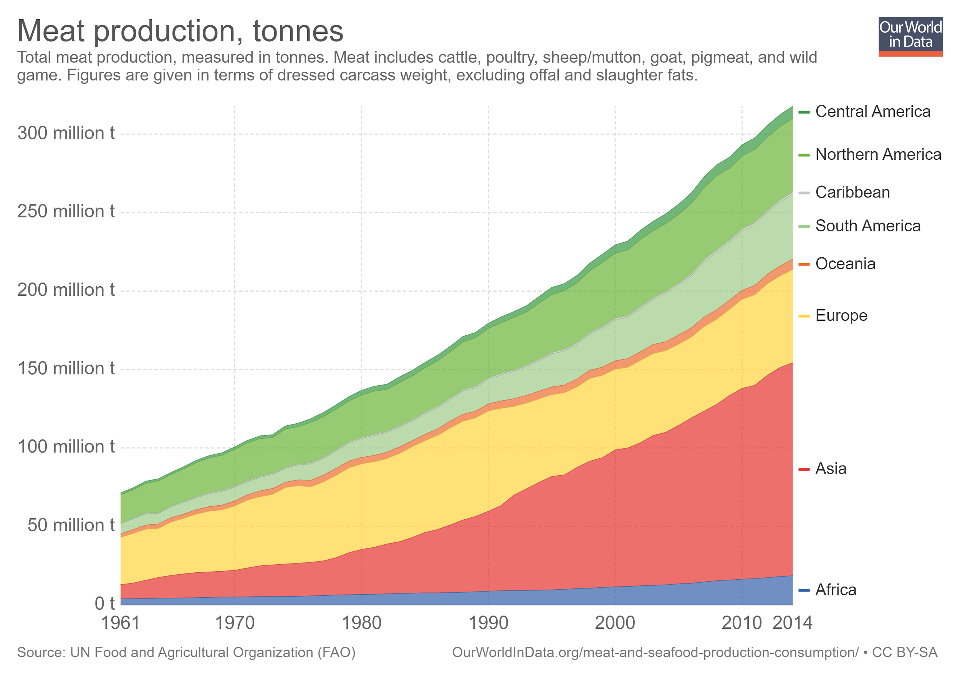
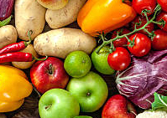
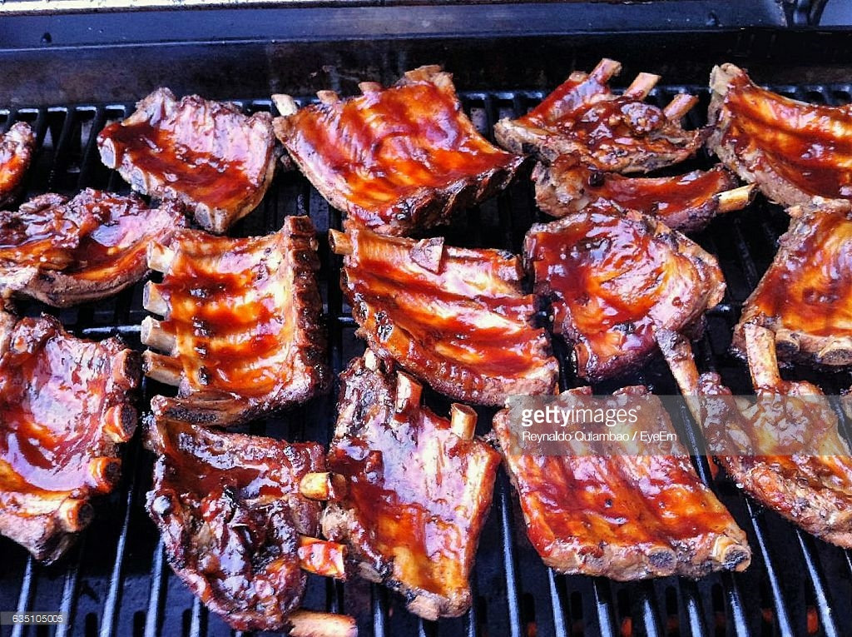
Motivation
Demand for food products with high environmental footprints is projected to grow based on income and population. (FAO 2013, Tilman and Clark 2014 and Clark and Tilman 2017).
Even if we increase production efficiency, changes in demand are needed to avoid agricultural expansion (Bajželj et al., 2014).
We need strategies to promote “greener diets”...

Slide 4
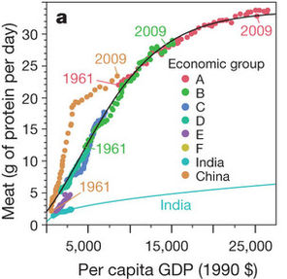
The Gap
But, we first need to understand what determines changes in diet.
We know that as countries become richer they consume more animal-based diets.
We don’t know to what extent dietary change occurs as a result of changes other than increasing income (demographics, preferences..)
Knowing this can give us an idea of how “manipulable” is diet via policy interventions.
Tilman and Clark, 2014

Slide 5
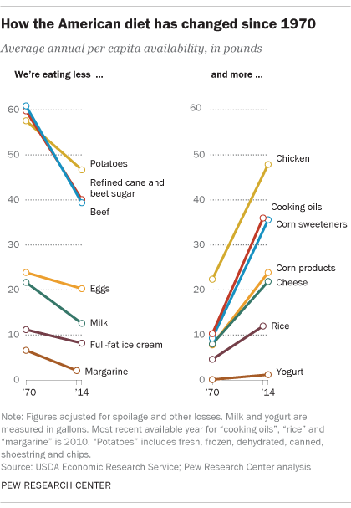
United States
Is one of the major meat consumers in the world - the second during 2013 (FAO).
There has been some work on dietary change in developing countries, but much less on dietary change in developed countries
Increase in income has lead to changes in preferences towards a cleaner mix of goods and services at the household level (Levinson & O’Brien, 2017).

Slide 6
Research Questions
What are the determinants of American dietary change and what are the implications with regard to demand side environmental food policy?
How has the environmental footprint of food consumption changed in the US?
To what extent is this change driven by income or other demographic effects over food preferences?
To what extent is this change driven by income or other demographic effects over national conditions that impact diet composition such as environmental policies?
What does the demand for meat looks like?
How would policy interventions like a meat or carbon tax, impact the demand for meat in the US?

Slide 7
Methods

Slide 8
Data Sources
U.S. Consumer Expenditure Survey (CEX), 1996-2016
EXIOBASE - Environmentally Extended Supply and Use / Input Output Database, 2000/2007
BEA (Bureau of Economic Analysis) Input/Output tables, 1963-2016
EPA National Emission Inventory (NEI), 2008/2011/2014
Economic and Agricultural Censuses, 2002/2007/2012

Slide 9
The General Approach
STEP 1: Aggregate the household food basket by year
-Data: U.S. CEX 1984 - 2016
STEP 2: Calculate pollution/carbon emission coefficients for different food types
-Data: EXIOBASE 2000/2007
STEP 3: Match CEX with IO pollution/carbon coefficients to calculate emission per household
STEP 4: Calculate Environmental Engel curves
STEP 5: Oaxaca-Blinder decomposition
-including price decomposition?
STEP 6: Use price data to model shifts of specific policy interventions
-Data: CPI
1. The average households environmental impact of food consumption over time
2. Dietary Environmental Engel Curves
The relationship between food expenditure and environmental impact
3. Decomposition of the dietary transition into income, demographic, and EEC shift components
4. Realistic effect of policy interventions on dietary choice

Slide 10
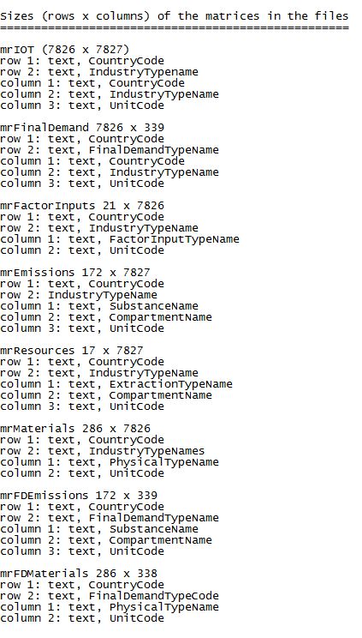
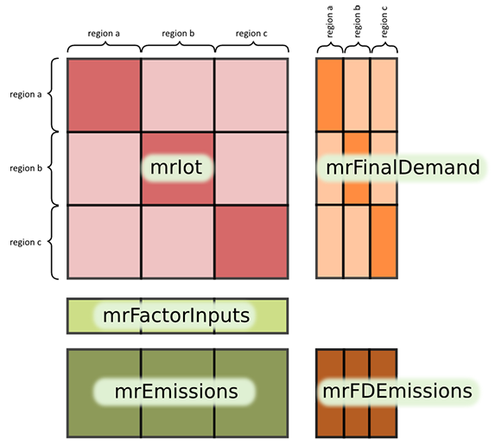
Exiobase Datasets
Given: Final demand Y and emission coefficient matrix F (kg/M EUR)
Calculation of input coefficient matrix A from IO Table
Calculation of Leontief inverse L = (I – A)⁻¹
Total output x = (I – A)⁻¹ y
Total emissions e = F x = F (I – A)⁻¹ y
Emission _{j} = ∑ F_{i, j} (I – A)⁻¹ (kg/$) ✕ CEX_{i} ($)
Where i indicates a food production industry
F_{i, j} is the coefficient of emission type j of i industry
CEX_{i} is the household expenditure on i food category
Notes:
CEX is equivalent to final demand y here.
F is the direct emission coefficient matrix, and F(I-A)⁻¹ is total emission coefficient matrix.
We need to convert euro to dollar on F.

Slide 11
Step 1: Aggregate the household food basket by year

Slide 12
The Household Food Basket Change
Data: U.S. CEX, 1984 - 2016
The Consumer Expenditure Survey (CEX) tracks 2000 household income and expenditure in approx 850 separate Universal Category Codes (UCC)
Gross household income and after tax income is estimated from the CEX
UCC corresponding to food items are extracted and aggregated from the CEX

Slide 13
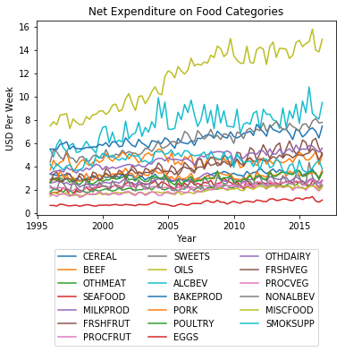
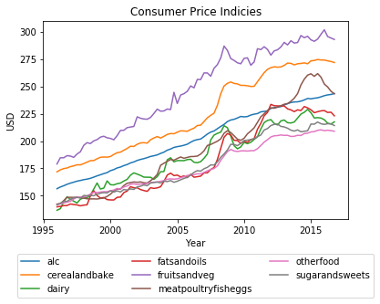
US Household Food Basket in 1996 and 2016

Slide 14
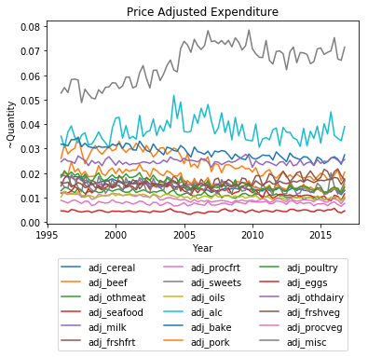
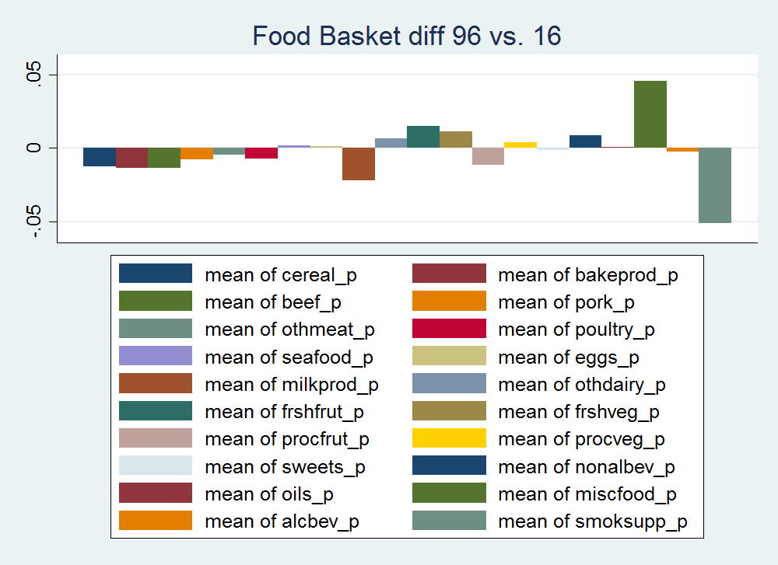
Differences in household food basket between 1996 and 2016

Slide 15
Step 2: Calculate emission intensity for different food types

Slide 16
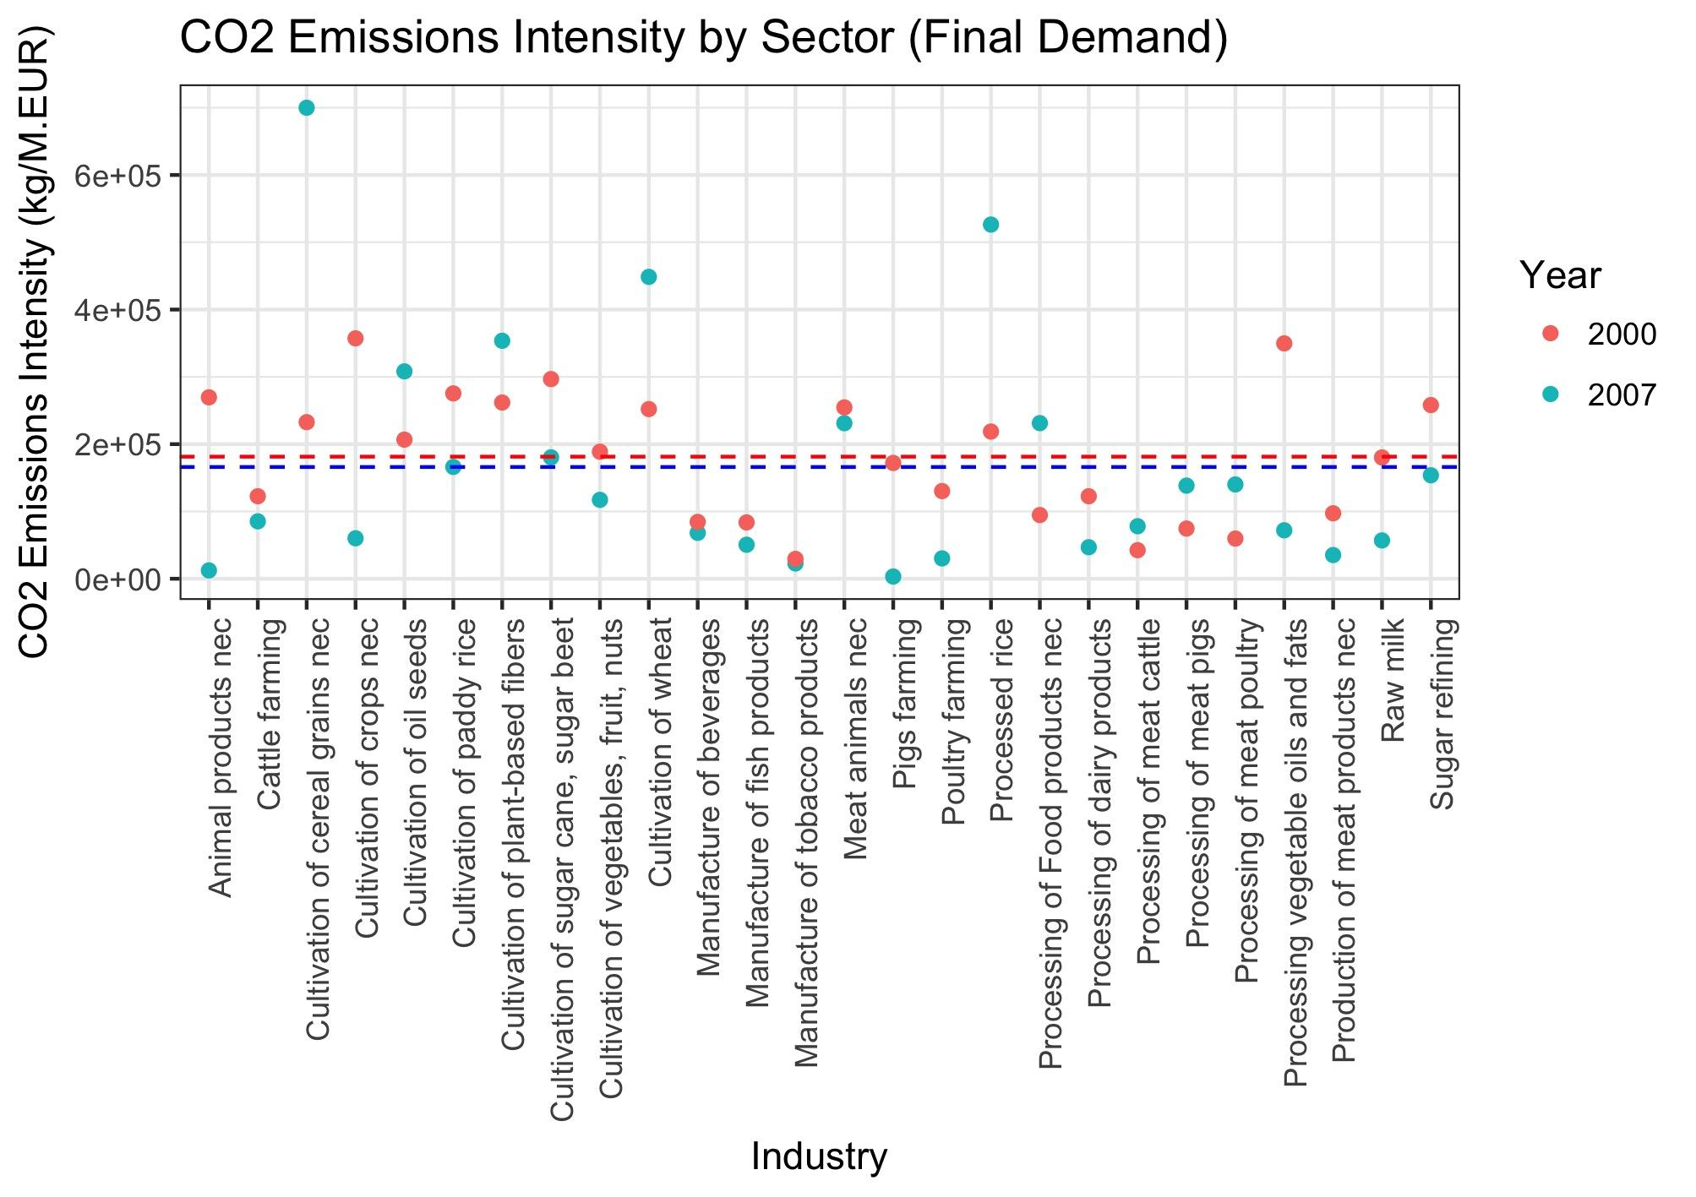

Slide 17
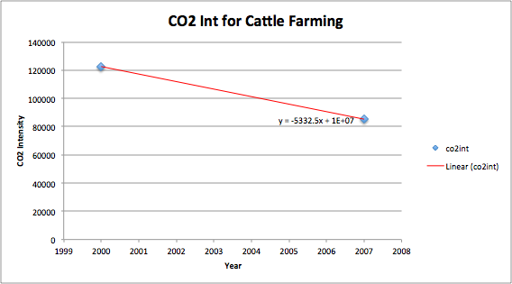
Technological change - assuming linearity

Slide 18
Step 3: Match CEX with IO carbon coefficients to calculate emission per household

Slide 19
Mapping CEX & EXIOBASE Food Categories
Cultivation of paddy rice
Cultivation of wheat
Cultivation of cereal grains nec
Cultivation of vegetables, fruit, nuts
Cultivation of oil seeds
Cultivation of sugar cane, sugar beet
Cultivation of plant-based fibers
Cultivation of crops nec
Cattle farming
Pigs farming
Poultry farming
Meat animals nec
Animal products nec
Raw milk
Processing of meat cattle
Processing of meat pigs
Processing of meat poultry
Production of meat products nec
Processing vegetable oils and fats
Processing of dairy products
Processed rice
Sugar refining
Processing of Food products nec
Manufacture of beverages
Manufacture of fish products
Manufacture of tobacco products
Cereals and cereal products
Bakery products
Beef
Pork
Other meats
Poultry
Fish and seafood
Eggs
Fresh milk and cream
Other dairy products
Fresh fruits
Fresh vegetables
Processed fruits
Processed vegetables
Sugar and other sweets
Fats and oils
Miscellaneous foods
Nonalcoholic beverages
Food away from home
Alcoholic beverages

Slide 20
New category | CEX category | EXIOBASE category
Cultivation of general cereal (cereal) | Cereals and cereal products Bakery products | Cultivation of paddy rice - weighted Cultivation of wheat Cultivation of cereal grains nec Processed rice - weighted
Cattle farming and processing (beef) | Beef | Cattle farming - weighted Processing of meat cattle - weighted
Pig farming and processing (pork) | Pork | Pigs farming - weighted Processing of meat pigs - weighted
Poultry farming and processing (poultry) | Poultry Eggs | Poultry farming - weighted Processing of meat poultry - weighted
Other meat and products (meat_other) | Other meat | Meat animals nec - weighted Production of meat products nec - weighted
Manufacture of fish products (fish) | Fish and seafood | Manufacture of fish products - weighted Fishing (production part) - weighted
Dairy products (dairy) | Fresh milk and cream Other dairy products | Processing of dairy products - weighted Raw milk - weighted
Fruits and vegetables (vegs) | Fresh fruits Processed fruits Fresh vegetables Processed vegetables | Cultivation of vegetables, fruit, nuts
Sugar and other sweets (sugar) | Sugar and other sweets | Cultivation of sugar cane, sugar beet - weighted Sugar refining - weighted
Fats and oils (oil) | Fats and oils | Cultivation of oil seeds - weighted Processing vegetable oils and fats - weighted
Beverage (beverages) | Alcoholic beverages Nonalcoholic beverages | Manufacture of beverages

Slide 21
Step 4: Build a time series of environmental engel curves

Slide 22
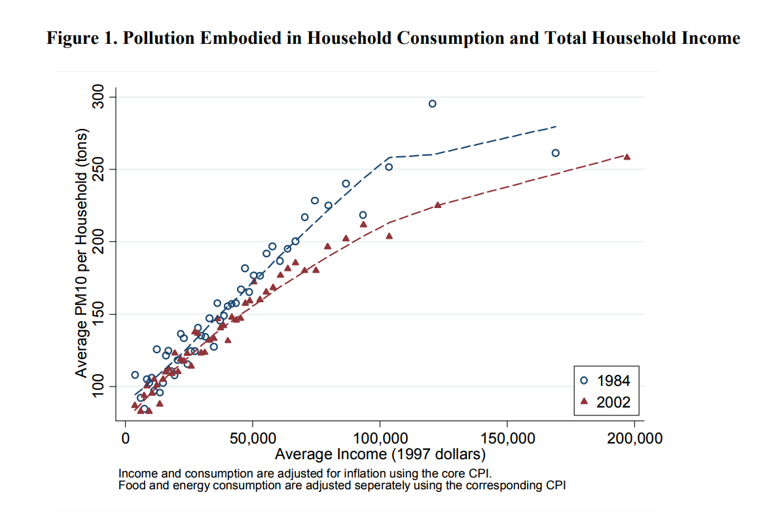
Example Findings - Embodied household pollution
Levinson, O’brien 2017

Slide 23
Step 5: Regression - Oaxaca Blinder Decomposition

Slide 24
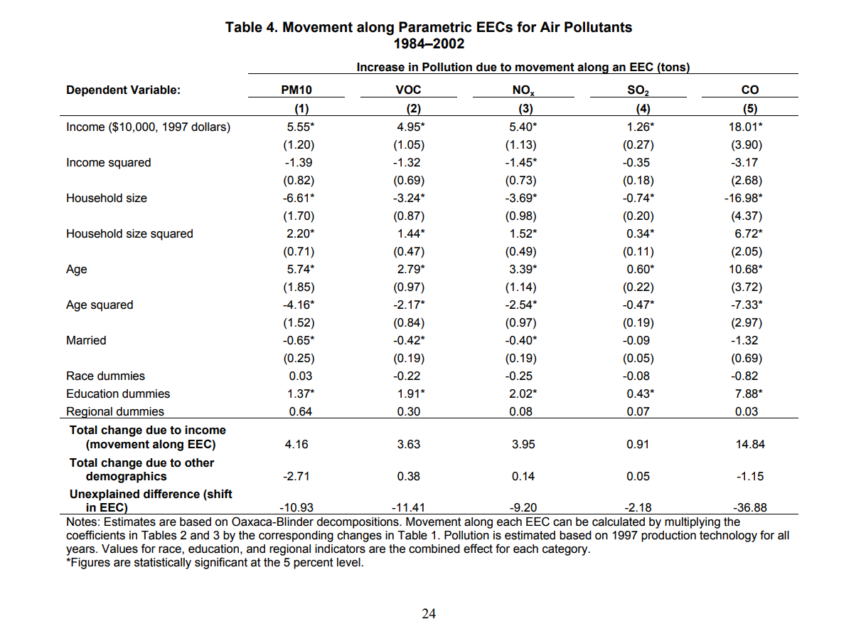
Example Findings - Pollution decomposition
Levinson, O’brien 2017

Slide 25
Step 6: Almost Ideal Demand System

Slide 26
AIDS: Almost Ideal Demand System
Estimate demand system from expenditure data
Possibility of welfare implications from policy interventions?

Slide 27
Step 7: Policy Implications

Slide 28
References
Bajželj, B., Richards, K. S., Allwood, J. M., Smith, P., Dennis, J. S., Curmi, E., & Gilligan, C. A. (2014). Importance of food-demand management for climate mitigation. Nature Climate Change, 4(10), 924.
Clark, M., & Tilman, D. (2017). Comparative analysis of environmental impacts of agricultural production systems, agricultural input efficiency, and food choice. Environmental Research Letters, 12(6), 064016.
FAO FAOSTAT. (FAO, 2013)
Levinson, A & O’Brien, J. (2017). Environmental Engel Curves. Working paper.
Tilman, David, and Michael Clark. "Global diets link environmental sustainability and human health." Nature 515.7528 (2014): 518.

Slide 29
Archives

Slide 30
EEC Paper Methodology
Total Emissions = Consumption category ✕ {Direct emission intensity + Indirect emission intensity}
GHG_{total} = ∑ CEX ($)_{i} ✕ { NEI (GHG)_{i}/ [ Census($)_{i} + BEA ($)_{i} ] }
Where i indicates a food production industry
NEI/Census gets us the GHG intensity (kg/$) of industry i (direct emissions)
NEI/BEA IO table gets us the GHG intensity (kg/$) of all upstream activities of industry i (indirect emissions)
Major problem: using 2002 emission intensity and assume technology stays the same
Notes:
Double counting? - using both NEI and BEA?

Slide 31
A Bite of China Paper Methodology
1992 V.S. 2007
Carbon Emissions (kg) = Emission Factor (kg/MJ) * Energy Intensity (MJ/$) * X ($)
UHIES (9 food types/44 types of commodities and services)
China’s Input-output Table (118/135 sectors)
China Energy Statistics Yearbook (36/44 sectors)
IPCC Emission Factors for Energy Types
Using 1992 emission intensity to calculate the 2007 emission and attribute the difference of actual emissions in 2007 to technology progress.

Slide 32
STEP 2: Calculate total pollution/carbon intensity coefficients for food basket items
Data: EPA National Emission Inventory (NEI), 2002/2005/2008/2011/2014
Economic and Agricultural censuses, 2002/2007/2012
BEA (Bureau of Economic Analysis) Input/Output tables, 1963-1996/1997-2016
The NEI is a detailed estimate of air pollution emissions in the United States compiled from reports submitted by state, local, and tribal air agencies
Calculate the per-dollar emissions intensity of each industry by aggregating industry-level emissions in the 2002 NEI and dividing by the total sales from the 2002 Economic and Agricultural censuses*
Match CEX with IO pollution/carbon coefficients to calculate emission per household
*We are exploring using 2017 data for both NEI (available) and the Census (not yet available). BEA data is available for 2016 - we are exploring if we can inflate the data to 2017 assuming constant I\O.

Slide 33
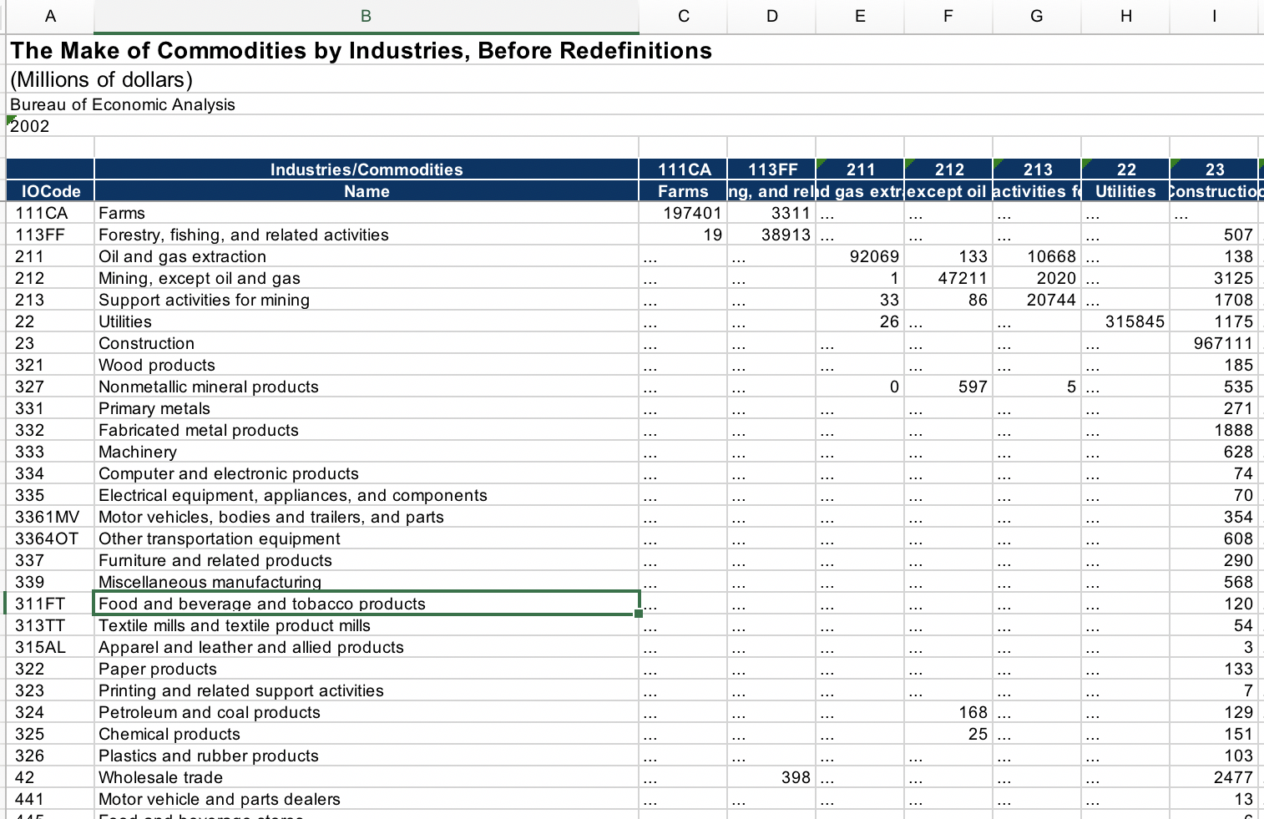
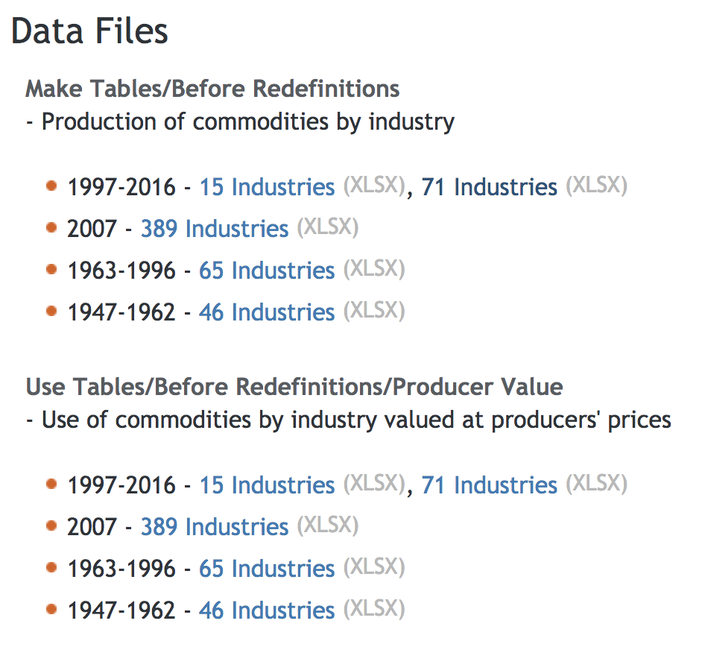
BEA IO Table
2002 IO Table
Food production industry:
111/113/311/313/315
Only 5 food-related categories in a 71 Industries version.
2007 Version may be good (389 Industries)

Slide 34
Economic and Agricultural censuses
Geographic Area Series: This series provides detailed industry statistics by geographic area for establishments of firms with paid employees.
(number of establishment, sales, annual payroll, first quarter payroll, number of paid employees for pay period, percent of sales from administrative records, percent of sales estimated)
Accommodation and food services
Food services and drinking places
Special food services
Food service contractors
Caterers
Mobile food services
Drinking places (alcoholic beverages)
Restaurants and other eating places
Full services restaurants
Limited services restaurants
Cafeterias, grill buffets and buffets
Snacks and nonalcoholic bars

Slide 35
Supply Side Considerations:
From a supply-side perspective the best way to meet growing food demand is through sustainable intensification of agriculture
Increased crop yields
Fertilizer improvements
Pesticide and irrigation use efficiency
Even if we take these improvements to their limits it won’t be enough.
Projections of global demand over the next 35 years suggest that supply side improvements will not be able to mitigate substantial increases in land use and other negative environmental impacts
Supply improvements are important, but not sufficient

Slide 36
We must think critically about demand
It is clear that eating less meat ceteris paribus is better for the environment.
It is clear that eating less calories is ceteris paribus better for our health.
But then why don’t we do these things???
Tastes!
There aren’t even available mechanisms that we know of that would induce these changes.
Consider a “sin” tax - a tax on meat
Politically disastrous
Ineffective anyway? - “Soda” tax (Fletcher 2010) shows people substitute towards other untaxed sugary drinks to the point of negating all potential health benefits
A GHG tax would be effective - no spillovers etc. but it’s not a food policy
Notes:
Env econ tells us that the least cost solution will be a GHG tax anyway
Vincent - what about taxes on land etc?

Slide 37
Furthermore, all of these policy interventions have significant welfare implications
People are less satisfied with forced changes in diet
Behaviorally, people are making trade-offs with food choice
Tasty satisfying foods vs. healthy, environmentally friendly, etc.
How are these trade-offs made?
Short term: they are not. Health diagnoses have no impact on diet composition in the short term (Oster, 2017)
Globally, diet transitions are occurring over longer periods of time
Income is certainly an important factor in this transition, what else is?
Healthiness consideration and environmentalism could be two other factors

Slide 38
Methodologies for demand analysis
Micro-scale policy analysis
Pros: Causal implication, external validity
Cons: Limited scope, difficulty finding relevant natural experiment
Data: Consumer budget survey over some policy transition, Aggregated food-LCA panels
Determinants of long term dietary transitions
Pros: Novel, scope matches what we need for environmental improvement
Cons: low causation
Data:
US consumer expenditure survey (CES) or hopefully longer? Century scale diet dynamics
World Bank Global Consumption Dataset (Food expenditure of 92 developing countries)
Computable general equilibrium analysis or dynamic stochastic general equilibrium
Pros: welfare implications can be derived, potential spillovers can be addressed
Cons: heroic modeling assumptions, no expert on the team
Data:
EXIOBASE (Input-output data of 43 major countries)
GTAP
Potential to combine two and three?
Notes:
Vincent - trend in food consumption - break down into technology, substitution, IPAT? Decomposition?
Next week - use WB data regress consumption data on price data - if Tilman says eat less meat and more other stuff - what does the cross elasticity looks like? Just simplify by having two sectors - meat and non meat + then add emissions analysis. Question - what’s the consumer welfare loss from dietary transition and how is that offset by positive welfare benefits from environmental gains? First make a BAU scenario with historical data. Then add demand side scenarios to it.
Mad cow and Tindersomething - for natural experiments.

Slide 39
What do we know
A study compiling LCA studies on food shows that a plant-based diet generates less GHG emissions, and also reduces disease (Tilman, 2014)
However, a study of households in Sweden found that consumer re-spending of the saving obtained from shifting to vegetarianism can lead to rebound effects (Grabs, 2015).
Recent research has evaluated water, GHG and land impacts of food of urban food consumption across different future scenarios such as new technologies for food production and improving nutritional outcomes (Boyer and Ramaswami, 2017).
Americans seem to be eating less beef today than they did ten years ago (~15%)

Slide 40
What don’t we know
While shifting to a vegetarian diet has been shown to be environmentally beneficial (Tilman, 2014), how will we achieve such a transition?
In order to achieve the transition, what are our options besides awareness creation and organic behavioural change from the bottom up? (Specific taxes on meat, a carbon tax, a focus on health?)
Once we take available policy instruments and behaviour into consideration, do we still achieve the same results as an ideal world analysis of 100% shift to vegetarianism?

Slide 41
Why we think this has value
Move the conversation beyond a purely technical analysis of emissions reductions (outcomes such as 100% veg diet, or calorie requirements)
Introducing
policy feasibility,
specific proposed and operational policy instruments,
individual behaviour and rebound into the analysis of dietary change

Slide 42
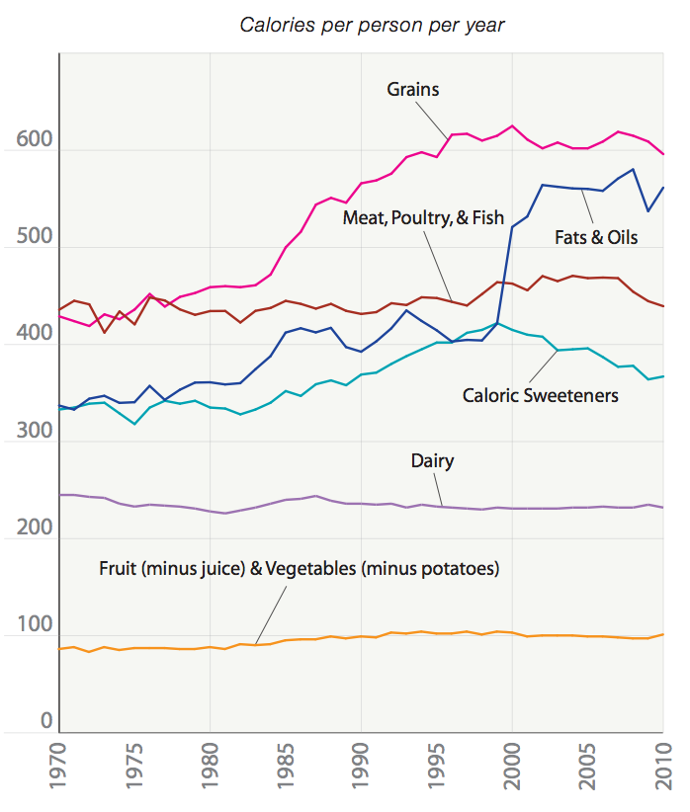
US changes in diet
Data from the USDA
(https://www.vox.com/a/explain-food-america)

Slide 43
Papers for reference
Global diets link environmental sustainability and human health
Environmental Impact Assessment of Household Consumption
The rebound effects of switching to vegetarianism
The Impacts of Dietary Change on Greenhouse Gas Emissions, Land Use, Water Use, and Health: A Systematic Review
Policies to promote healthy eating in Europe
Environmental impact of dietary change: a systematic review
Importance of food-demand management for climate mitigation

